Slide 1
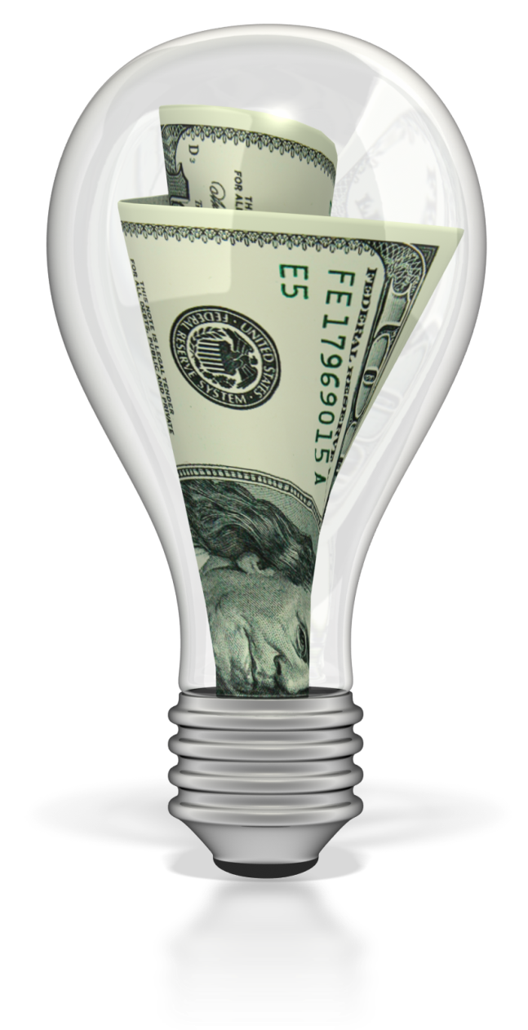
SAVE ENERGY
The Easy Way

Slide 2
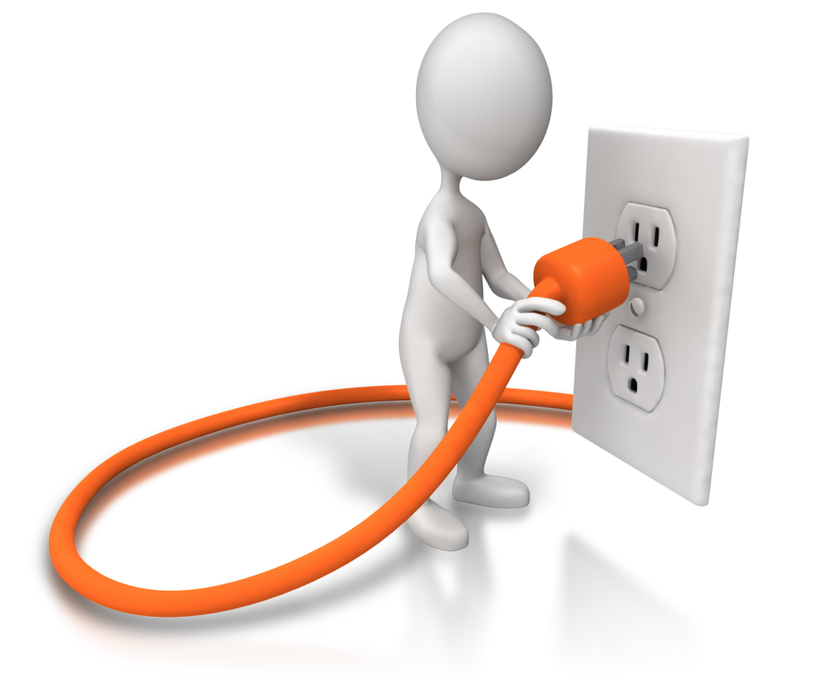
Why do I need to save energy?
"Over 16 Billion Dollars of
Electricity is unusable energy,
but billable in the U.S."
-US Department of Energy

Slide 3
Why do I need to save energy?
Up to 25% or More of the Energy You Pay For Goes Unused
40-60% of Your Power Bill Comes from Heating/Cooling Costs

Slide 4
Why do I need to save energy?
Most Electric Motors Run at 80% Efficiency or Less
Considerable Savings Can Be Achieved By Reducing The Cost of Running Electric Motors According to NASA & US Department of Energy Research

Slide 5
Electricity Costs
1960’s - .019/kwh
1970’s - .044/kwh (Energy Crisis)
2000’s - .10+ /kwh
COSTS ARE SKYROCKETING!

Slide 6
Save Energy, Save The Earth
Global Warming Is A REAL THREAT!
Reap Financial Benefits NOW While Also Saving Our Planet
Energy Efficiency is an Investment In YOUR Future
Go Green By Reducing Your Carbon Footprint

Slide 7
Costly Solution
Electrical Engineer ($150/hr)
Adjusts Motors, Compressors or Power Panels Individually
Designs Unit For Each Inductive Load or Panel
Manufactures to SPEC for Each Motor or Panel Through A Contract With A Separate Company
Hire an Electrician to Install Equipment
TOTAL COST IS NOT WORKABLE= $30,000-$150,000

Slide 8
It Would Take Years To
See A Return On That
Investment!

Slide 9
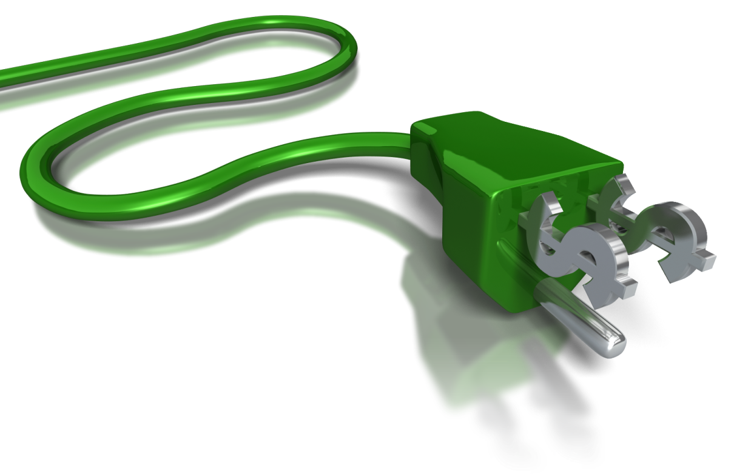
The Solution
Our Energy Saving Unit:
Made Right Here in the USA!
Designed to Make the Motors in Your Home or
Business more efficient

Slide 10
The Solution
Our Energy Saving Unit:
Saves You Up to 25% or More On
Your Energy Bill Per Month
Protects Your Motors & Appliances From
Power Surges!

Slide 11
How does it work?
Inefficient System
Power Company Benefits
When Motors in Your Home Turn On:
Power is Demanded from your Power Company
This demand of power goes through the wiring on your property.
Throughout This Process:
The Wiring in Your Home Heats Up & Strains the Motor and Wiring.
The Heat Generated From This Process is Called Watts.
When the inefficient motors in your home run, there is lost energy that you are billed for by your energy company.

Slide 12
How does it work?
When Inefficient Motors In Your Home or Business Run:
YOU Are Billed (For That Inefficiency or Lost Energy) EVERY MONTH by your Energy Provider.

Slide 13
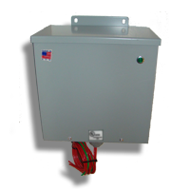
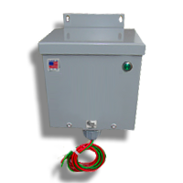
Our Product
For Businesses:
For Homes:

Slide 14
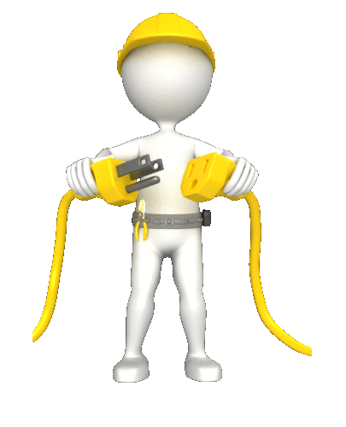
What can we do for you?
Our Power Saving Unit:
Recycles (Otherwise Lost Energy/Watts)
Releases It Back To Your Motor When Needed
Reduces The Amount Of Heat On The Wires And Motors In Your Home or Business.
Thus Lowering Your Electricity Bill and Lengthening the life of your motors.

Slide 15
Do I Have Motors on My Property?
Do you have:
Central Air Conditioner
Pool Pumps
Heat Pumps
Refrigerator
Freezer
Washer/Dryer
Ceiling Fans
T-12 Fluorescent Lighting Ballast
Power Tools
Elevators, Escalators
Anything with Copper Windings That Create Electromagnetic Fields

Slide 16
You may have some questions…
Is This Equipment Safety Certified?
Yes, Underwriters Laboratories inspects our facility randomly several times a year to ensure all our models meet all safety standards. Our UL & CuL file number is E342228.

Slide 17
You may have some questions…
Do You Have Product Liability Insurance?
Yes, We As The Product Manufacturer Carry A $2M Dollar Policy To Protect You And Your Loved Ones.

Slide 18
You may have some questions…
How Much Will I Save?
Savings Varies on Many Factors Such As: Age of Motors, Age of Wiring in Your Home or Business, How Many Hours You Run the Motors Each Day, etc.
Each Property Is Different. The Average Our Customers are Reporting is 10-15% but Again this depends on the Factors Above. Some Have Seen More Savings Than This But Is Not The Average. This is Why We Offer A Satisfaction Guarantee! If You Are Not Happy For ANY Reason, Then Neither Are We!

Slide 19
Hear What Our Customers Are Saying
“The LOWEST Electric Bill I Have Had Since I Bought The House in 2009!!!- THANKS!”

Slide 20
Hear What Our Customers Are Saying
"My Electric Bill was cut in half! Great Product, Great Price, Easy to Install By My Brother In Law. He Wants One Now After I Told Him How Much I Save On My Electric Bill. The Unit Paid For Itself In The First Month."

Slide 21
Hear What Our Customers Are Saying
"I Installed This And Believe I Have Made My Money Back In
Less Than 60 days!“
Mike R., North Carolina

Slide 22
Start Seeing A Difference Today!
Save a Ton of Money on Your Energy Bill!
Extend the Life of the Appliances & Expensive Motors on your Property Now!
Reduce Your Carbon Footprint Affecting Many Generations To Come

Slide 23
START SAVING MONEY & Reduce Your Energy Usage NOW!
It couldn’t be easier…..

Slide 24
Phone: (your Phone Number Here)
Contact: (YOUR NAME HERE)

